Slide 1
UE19CS390A – Capstone Project Approval
Project Title :Recipe Recommendation Based On Ingredients Recognition Using CV AND ML(RRIR)
Project ID :14
Project Guide :Prof Swati
Project Team :A R Manyatha
Amulya Dinesh
Manasi Swain
Mihir Soni

Slide 2
Outline
Problem Statement
Scope and Feasibility study
Applications/Use cases
Expected Deliverables
Capstone (Phase-I & Phase-II) Project Timeline
Gantt Chart
Any other information

Slide 3
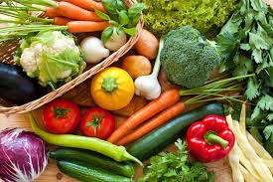
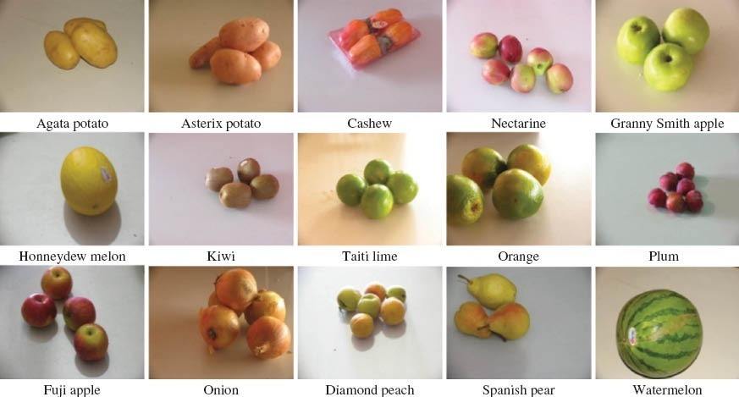
Problem Statement
Using camera to scan the ingredients present in the pantry and provide the user all the dishes and recipes possible

Slide 4
Scope and Feasibility study
There are 3 parts to this project:
CV-To scan the ingredients
ML-To label the ingredients
SEARCH/WEB SCRAPING-Search for recipes from the dataset based on the ingredients , if recipe not there then perform web scraping.
We have relevant found datasets for ingredients and recipe mapping and dataset with ingredient pictures(mainly for fruits/vegetables)

Slide 5
Applications/Use cases
People who want to learn how to cook
People who want to try new recipes
People who are not sure what to cook based on the available ingredients
Inspires new ideas and activities in the kitchen for new cooks, busy parents, foodies, and pro chefs alike.

Slide 6
Expected Deliverables
Capstone-I deliverables
-Literature survey
-Search for models
-Bring modifications to models
-Enrich our dataset by training with new ingredient pictures
Capstone-II deliverables
-Design implementation
-Design optimization
-Paper publishing

Slide 7
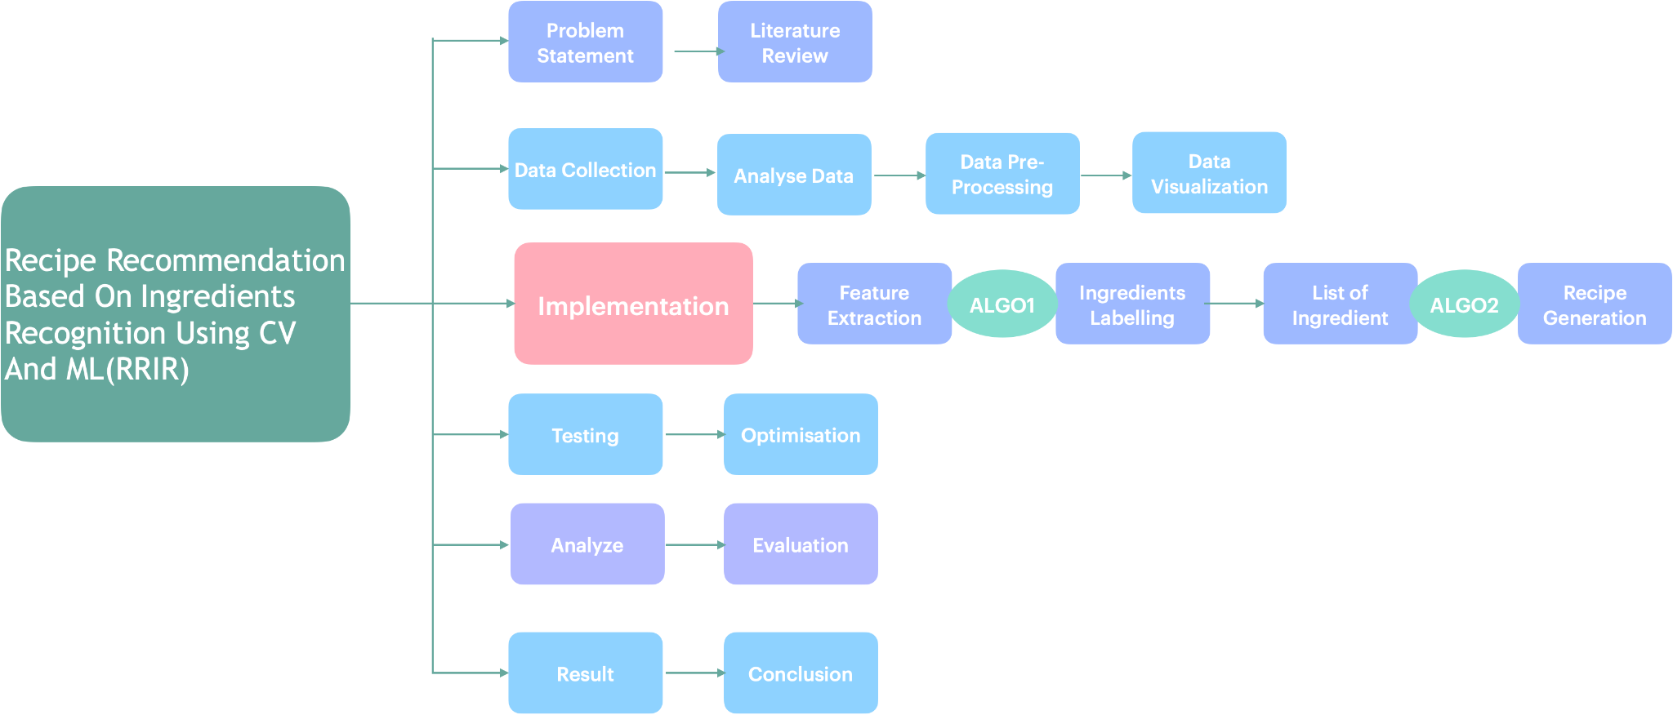
Capstone (Phase-I & Phase-II) Project Timeline

Slide 8
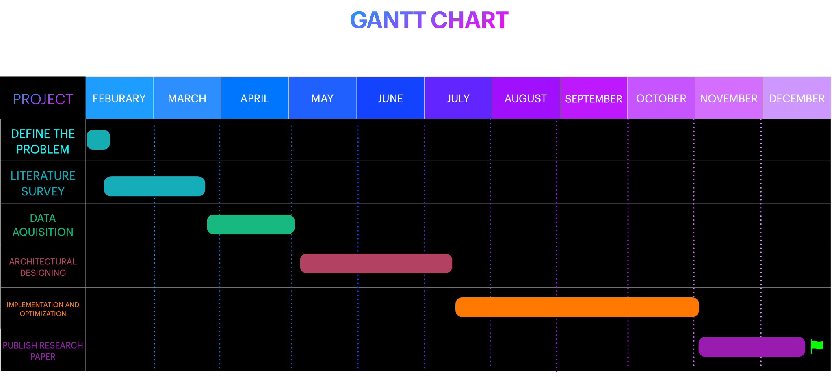

Slide 9
Any other information
FUTURE SCOPE:
Convert this project to an app
Better dataset for object classification
Customize to Indian cuisine
SHORTCOMINGS:
Dataset for other ingredient(images) not present
Optimization
Detection of spices using CV

Slide 10
Thank You

